Slide 1
Lyrics2PhotoStream: Content Based Visualization of Song Lyrics
By SP Kumar, Enkai Ji and Michael Albuquerque

Slide 2
Project Goal
To summarize the lyrics of a song into a photo stream which effectively summarizes its content

Slide 3
Motivation
Content based song recommendation
Visual summarization of text: powerful indicator of interest
Enhancing overall cognition while experiencing a song

Slide 4
Challenges
Data: Processing song lyric data
Discovery: Designing an innovative algorithm to capture
Discourse: Effective visualization

Slide 5
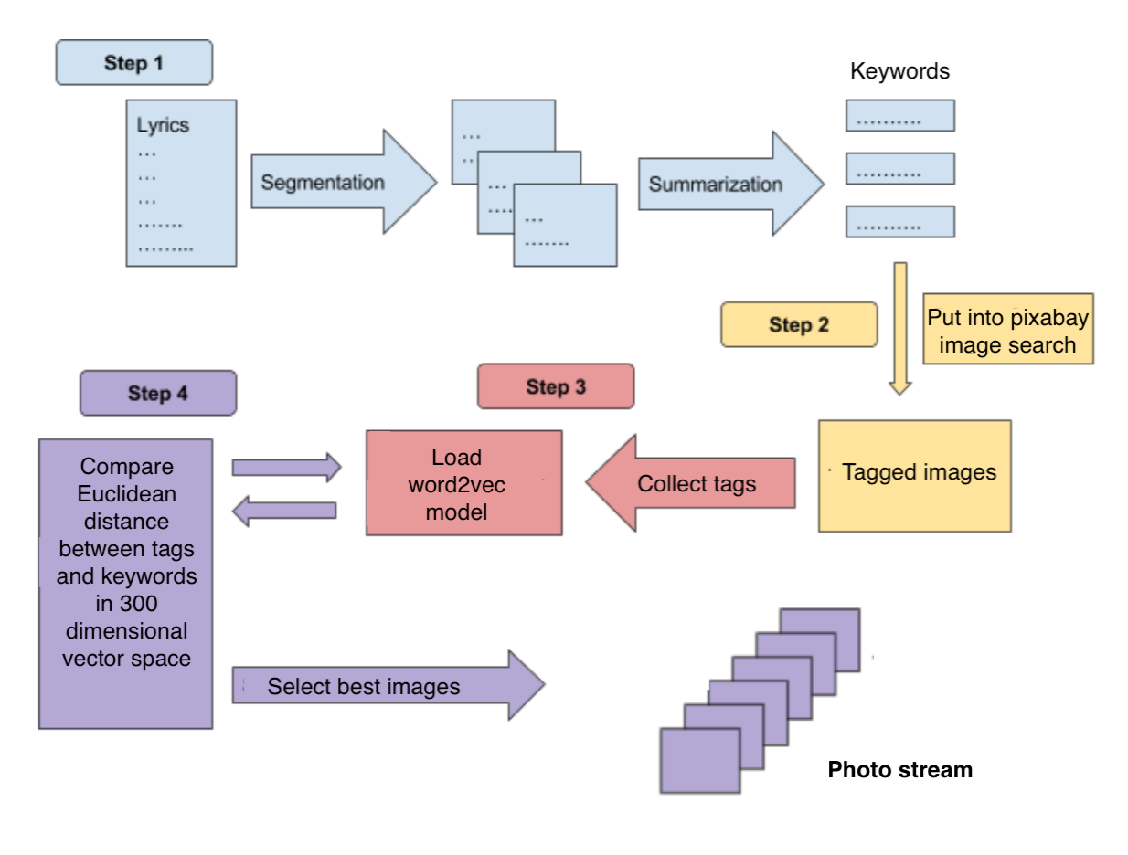
Technical Framework

Slide 6
Assumptions
An image is described only by its tags
The best image is the one which is semantically most relevant to its tags
In the word2vec dataset, words that are closer together in vector space have more of a similar

Slide 7
Algorithm 1: Simple Average
Each keyword k from the set of keywords { k₁, k₂, k₃,... k_{l}} has queried a set of images i₁, i₂, i₃… i_{m}
Each image i₁ has tags t₁₁, t₁₂, t₁₃,... t_{1n} associated with it
Take the average of vectors of all the images t₁₁, t₁₂, t₁₃,... t_{1n} as t₁
Take the Euclidean distance between k1 and t1 , similarly for k1 and t2 , …., k1 and tn
Select the image i_{k} corresponding to the minimum Euclidean distance
Idea: Each tag contributes equally to the meaning of the image.
Taking the average of the vectors of the tags would indicate which set of tags were most likely to be similar in meaning to the keyword.

Slide 8
Algorithm 2: Underlying Semantic Association
Each keyword k from the set of keywords { k₁, k₂, k₃,... k_{l}} has queried a set of images i₁, i₂, i₃… i_{m} .Each image i₁ has tags t₁₁, t₁₂, t₁₃,... t_{1n} associated with it.
Take the Euclidean distance between of vectors of k₁ and t₁₁ as k₁t₁₁ , k₁ and t₁₂ as k₁t_{12 , …} k_{n} and t_{1n} as k₁t_{11.} Repeat for i₂, i₃… i_{m}
Now rescale all these distances between 0 and 1. Since distance is a measure of dissimilarity, subtract from 1 to get a measure of similarity
Add up the similarity k₁t₁₁’ + k₁t₁₂ ’ + .. k₁t_{1n1}’ = k₁t₁ ’ k₁t₂₁’ + k₁t₂₂ ’ + .. k₁t_{2n2}’ = k₁t₂ ’ , …
k₁t_{m1}’ + k₁t_{m2} ’ + ..k₁t_{mnm}’ = k₁t_{m} ’
k₂t₁₁’ + k₂t₁₂ ’ + .. k₂t_{1n1}’ = k₂t₁ ’
k₂t₂₁’ + k₂t₂₂ ’ + .. k₂t_{2n2}’ = k₂t₂ ’
k2tm1’ + k2tm2 ’ + ... k2tmnm’ = k2tm ’
Select the image corresponding to the maximum similarity (k₁t_{k}’ + k₂t_{k}’+ k₃t_{k}’+ … k_{l}t_{k}’)
Idea: There are hidden underlying semantic associations between keywords in a paragraph. By comparing every other keyword with every other tag, we can identify the best set of tags.

Slide 9
Results and Analysis
We compared the algorithms for a few songs to determine performance qualitatively and also scope for improvement.
We found that the second algorithm outperforms the first in most cases.

Slide 10
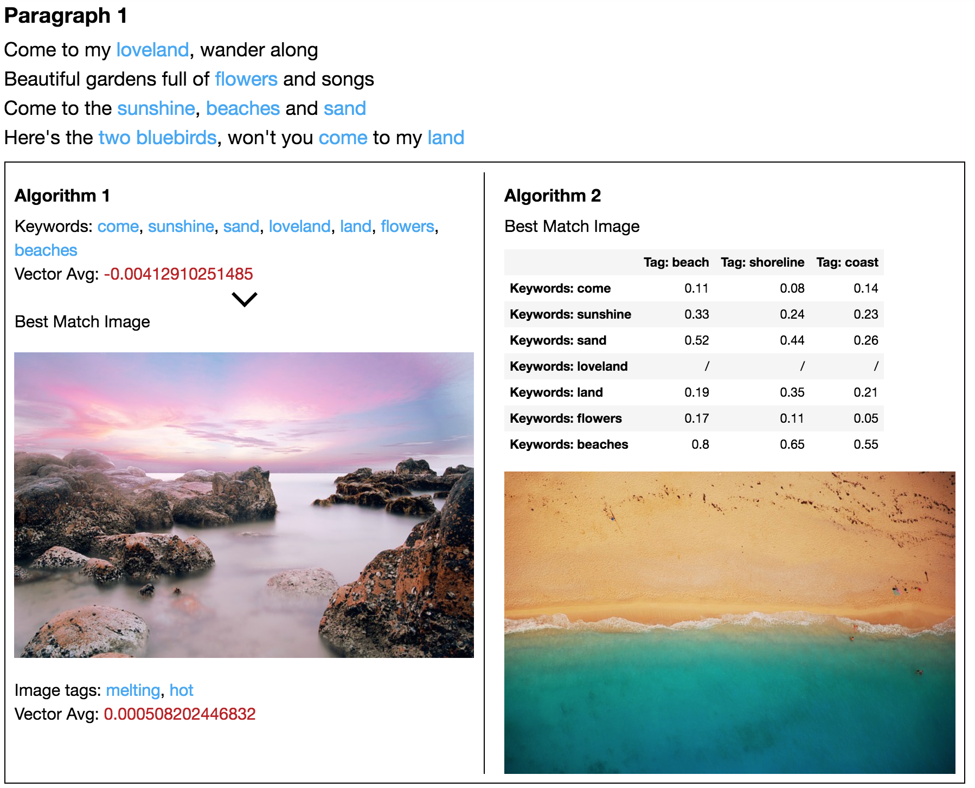

Slide 11
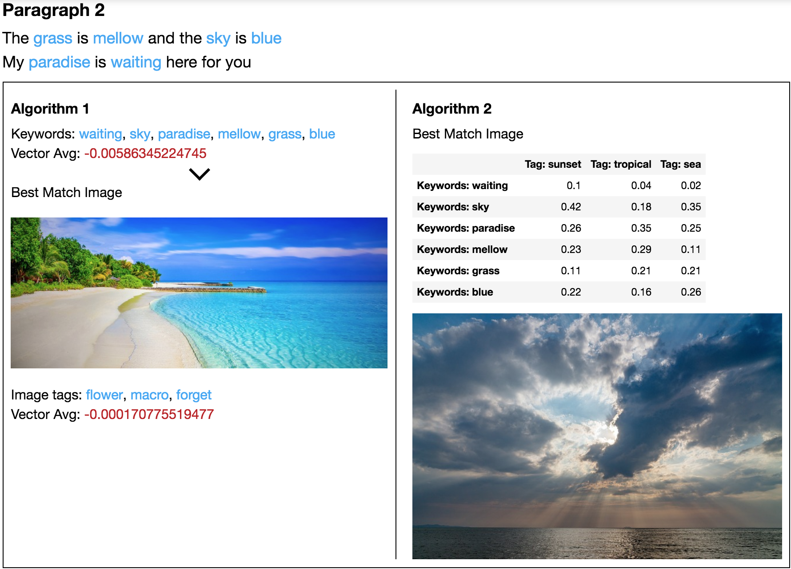

Slide 12
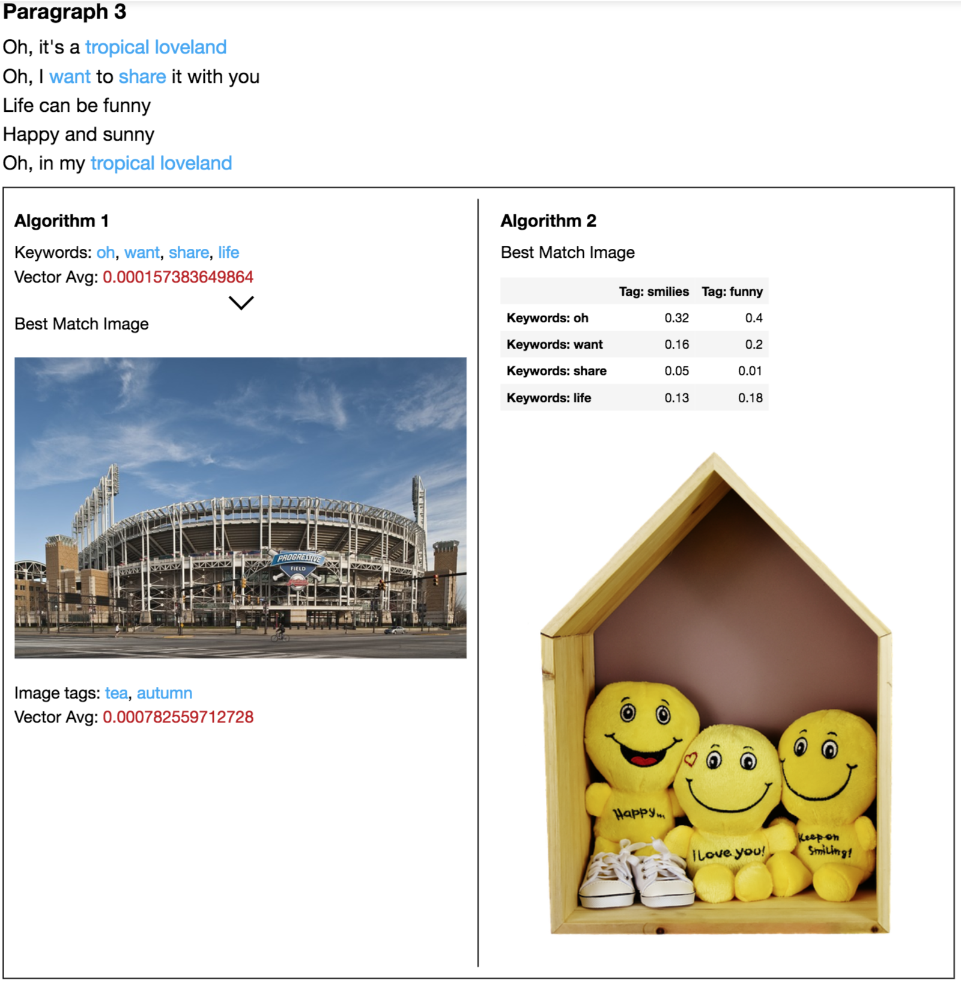

Slide 13
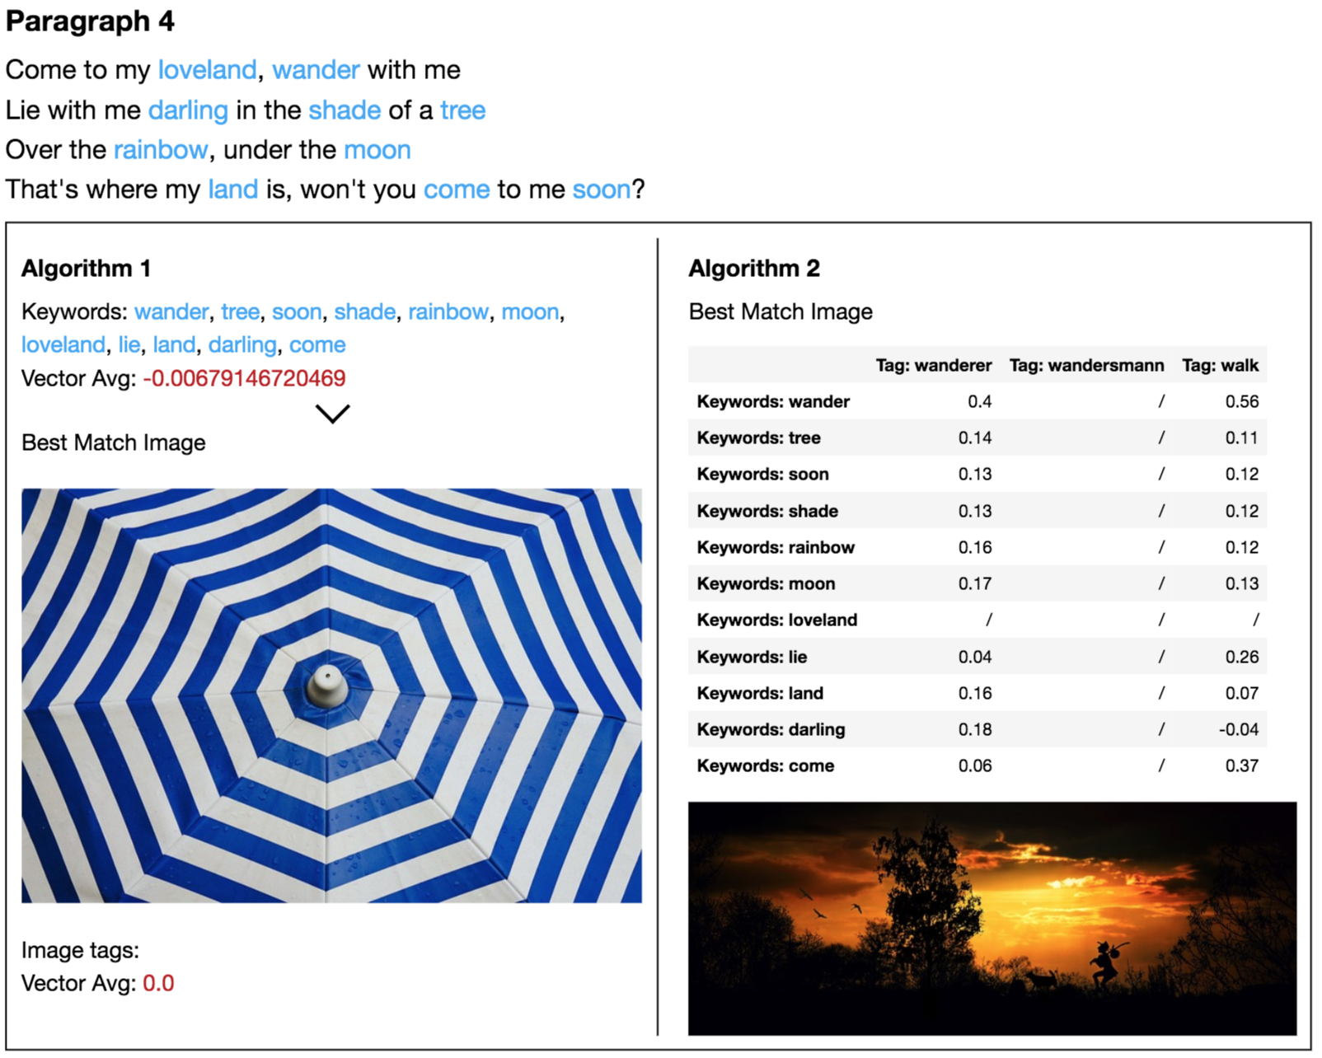

Slide 14
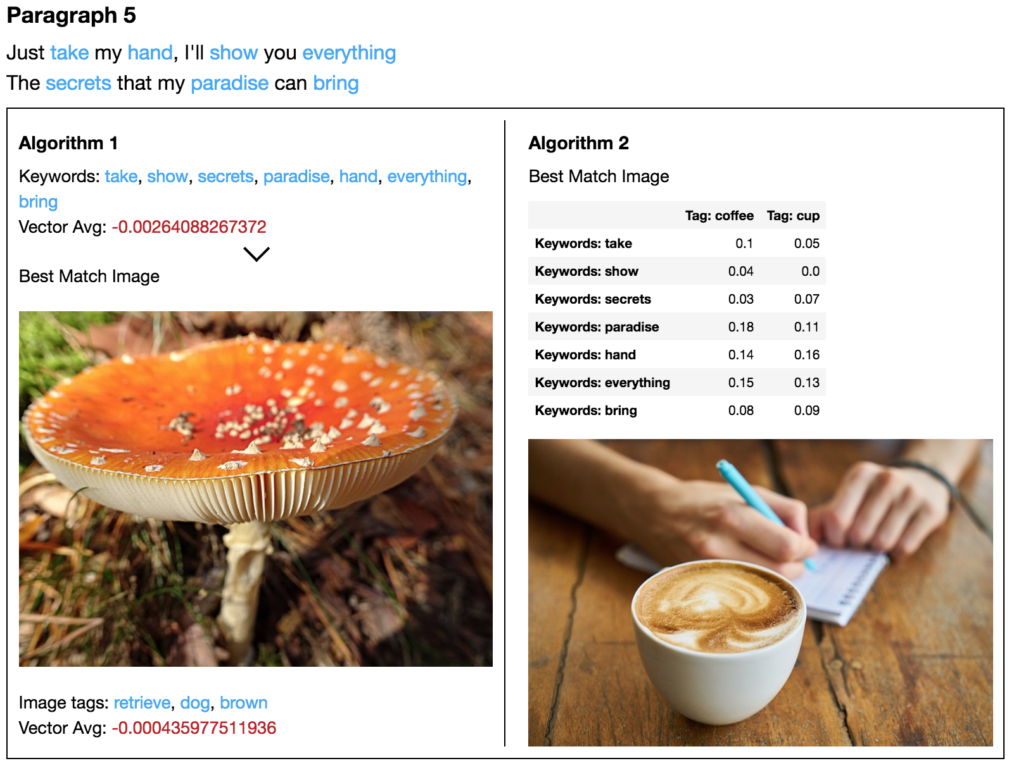

Slide 15
Analysis
Algorithm 1
Difficult to substantiate why image was picked
In most cases arbitrary, performs poor when exact matches not found.
Algorithm 2
Captures underlying associations between a set of keywords and a set of tags well
When good matches are not found, favors images with more tags. Is not penalised for using more tags and is biased towards such images.

Slide 16
Algorithm 2 (cont.)
Multi-word keywords are favored by RAKE but do not exist in the word2vec list of words do not help the algorithm
Performs well in comparison with ground truth (user selected image operating under the same assumptions)

Slide 17
Remaining Steps
Tweak the algorithm to handle a variety of cases
Multi-word keywords as favored by RAKE do not have much significance anymore, we would rather pick nouns and adjectives as picked by StanfordCoreNLP
Add a penalty function to eliminate giving high scores to images with more tags

